Slide 1
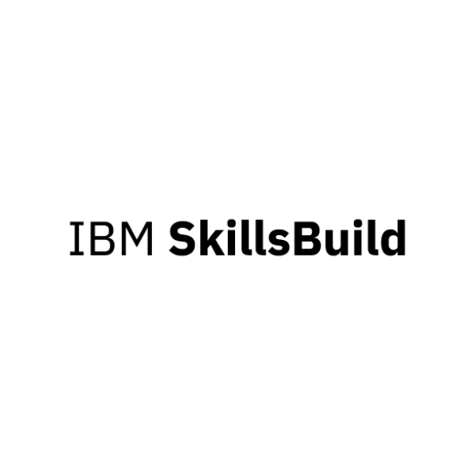




IBM AI-ML Internship Project
Title:
HealthBridge – AI Chatbot for Mothers & Children
Subtitle:
Empowering maternal & child healthcare with intelligent, accessible solutions
Presented by: Beta_Coders
Team Members:
V. Srujana
D. Devika
I. Srimai
A. Hansika
J. Likhithanjali
B. Umesh
M. Vardhan
College Name:
JAWAHARLAL NEHRU TECHNOLOGICAL UNIVERSITY HYDERABAD
UNIVERSITY COLLEGE OF ENGINEERING JAGTIAL

Slide 2

The Challenge
The Healthcare Reality in Rural India
800+ maternal deaths every day worldwide – many preventable
Lack of real-time guidance for pregnancy, childcare, and nutrition
Language and literacy barriers block access to online health info
Overcrowded clinics & underdiagnosed maternal mental health issues
Internet-dependent apps don’t work where they’re most needed

Slide 3





Our Solution
AI Symptom Checker for mother & baby
Pregnancy & child nutrition plans
Mental health support with sentiment detection
Immunization timelines (WHO/UNICEF compliant)
Works offline using SQLite
Local language support via translation APIs
Intuitive design for low-literacy, low-tech users
Meet HealthBridge
A multilingual, AI-powered chatbot delivering trusted maternal and child health support - anytime, anywhere.

Slide 4

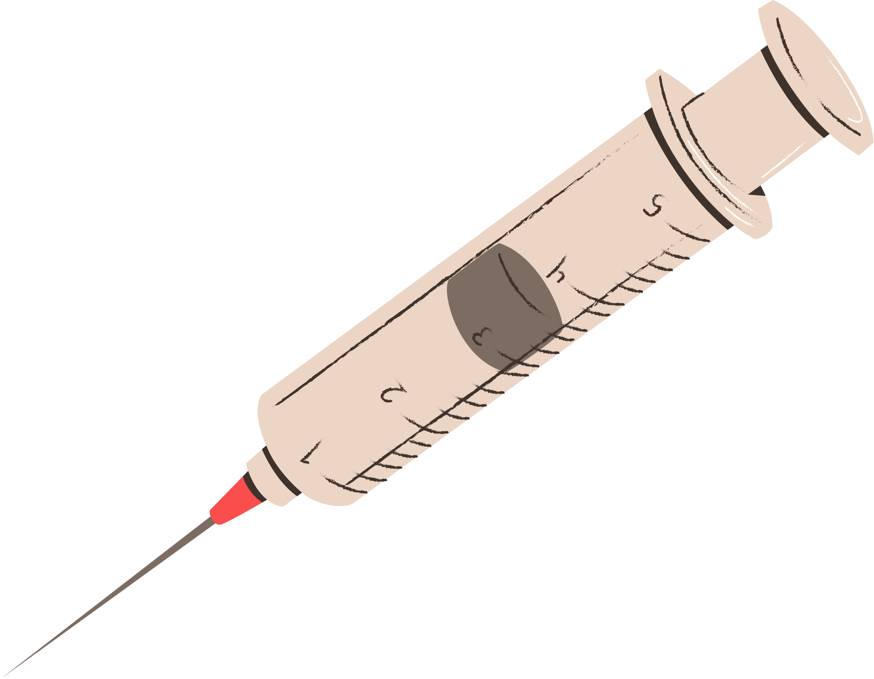

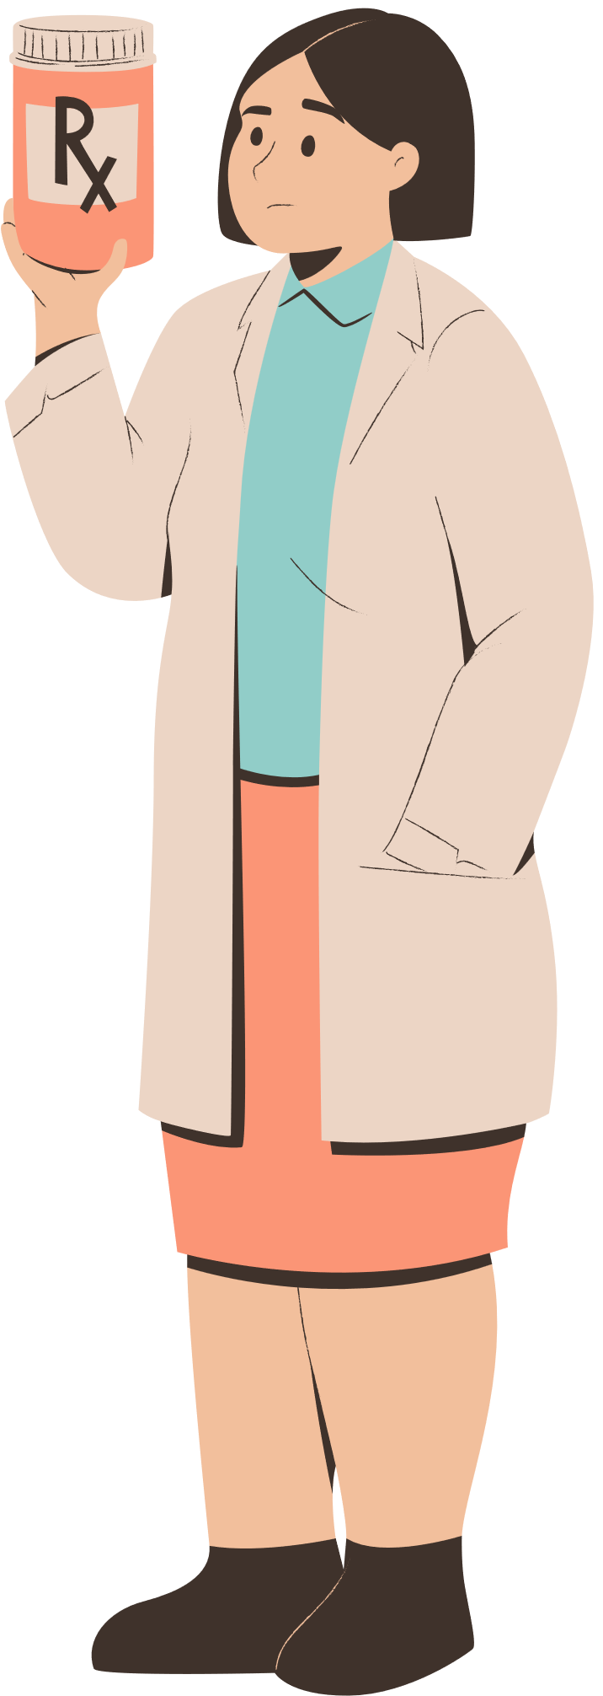
Vision & Objectives
Democratize health access for underserved communities
Deliver real-time, empathetic, and AI-driven care
Enable early intervention and reduce preventable health issues
Build a scalable digital health assistant tailored for rural use
Support mothers holistically
physical + emotional wellbeing

Slide 5
Core Features
Module | Description | Sample Input | Output
Symptom Checker | Suggests causes, urgency, and care steps | “My baby has a fever and rash” | “Could be measles. Hydrate, see doctor if persists”
Maternal Guidance | Nutrition, antenatal/postnatal advice | “What to eat in 2nd trimester?” | Nutritional plan in simple terms
Mental Health Bot | Sentiment detection, helplines | “I cry every day” | Suggests mental support + helpline
Immunization Info | Vaccine schedule based on age | “What vaccines this month?” | Timeline with visuals
Multilingual Chat | Localized conversation | “మా బిడ్డకి జలుబు” | Responds in Telugu

Slide 6

What Makes HealthBridge Special?
Key Differentiators
Offline-First: Works in no/low internet zones using SQLite
Hardware-Free: No sensors or wearables needed
Emotion-Aware: Sentiment analysis for mental wellness
Inclusive Design: Local language + visual prompts
Minimalist UI: Streamlit-based, simple for all ages
Trusted Content: WHO & UNICEF aligned

Slide 7
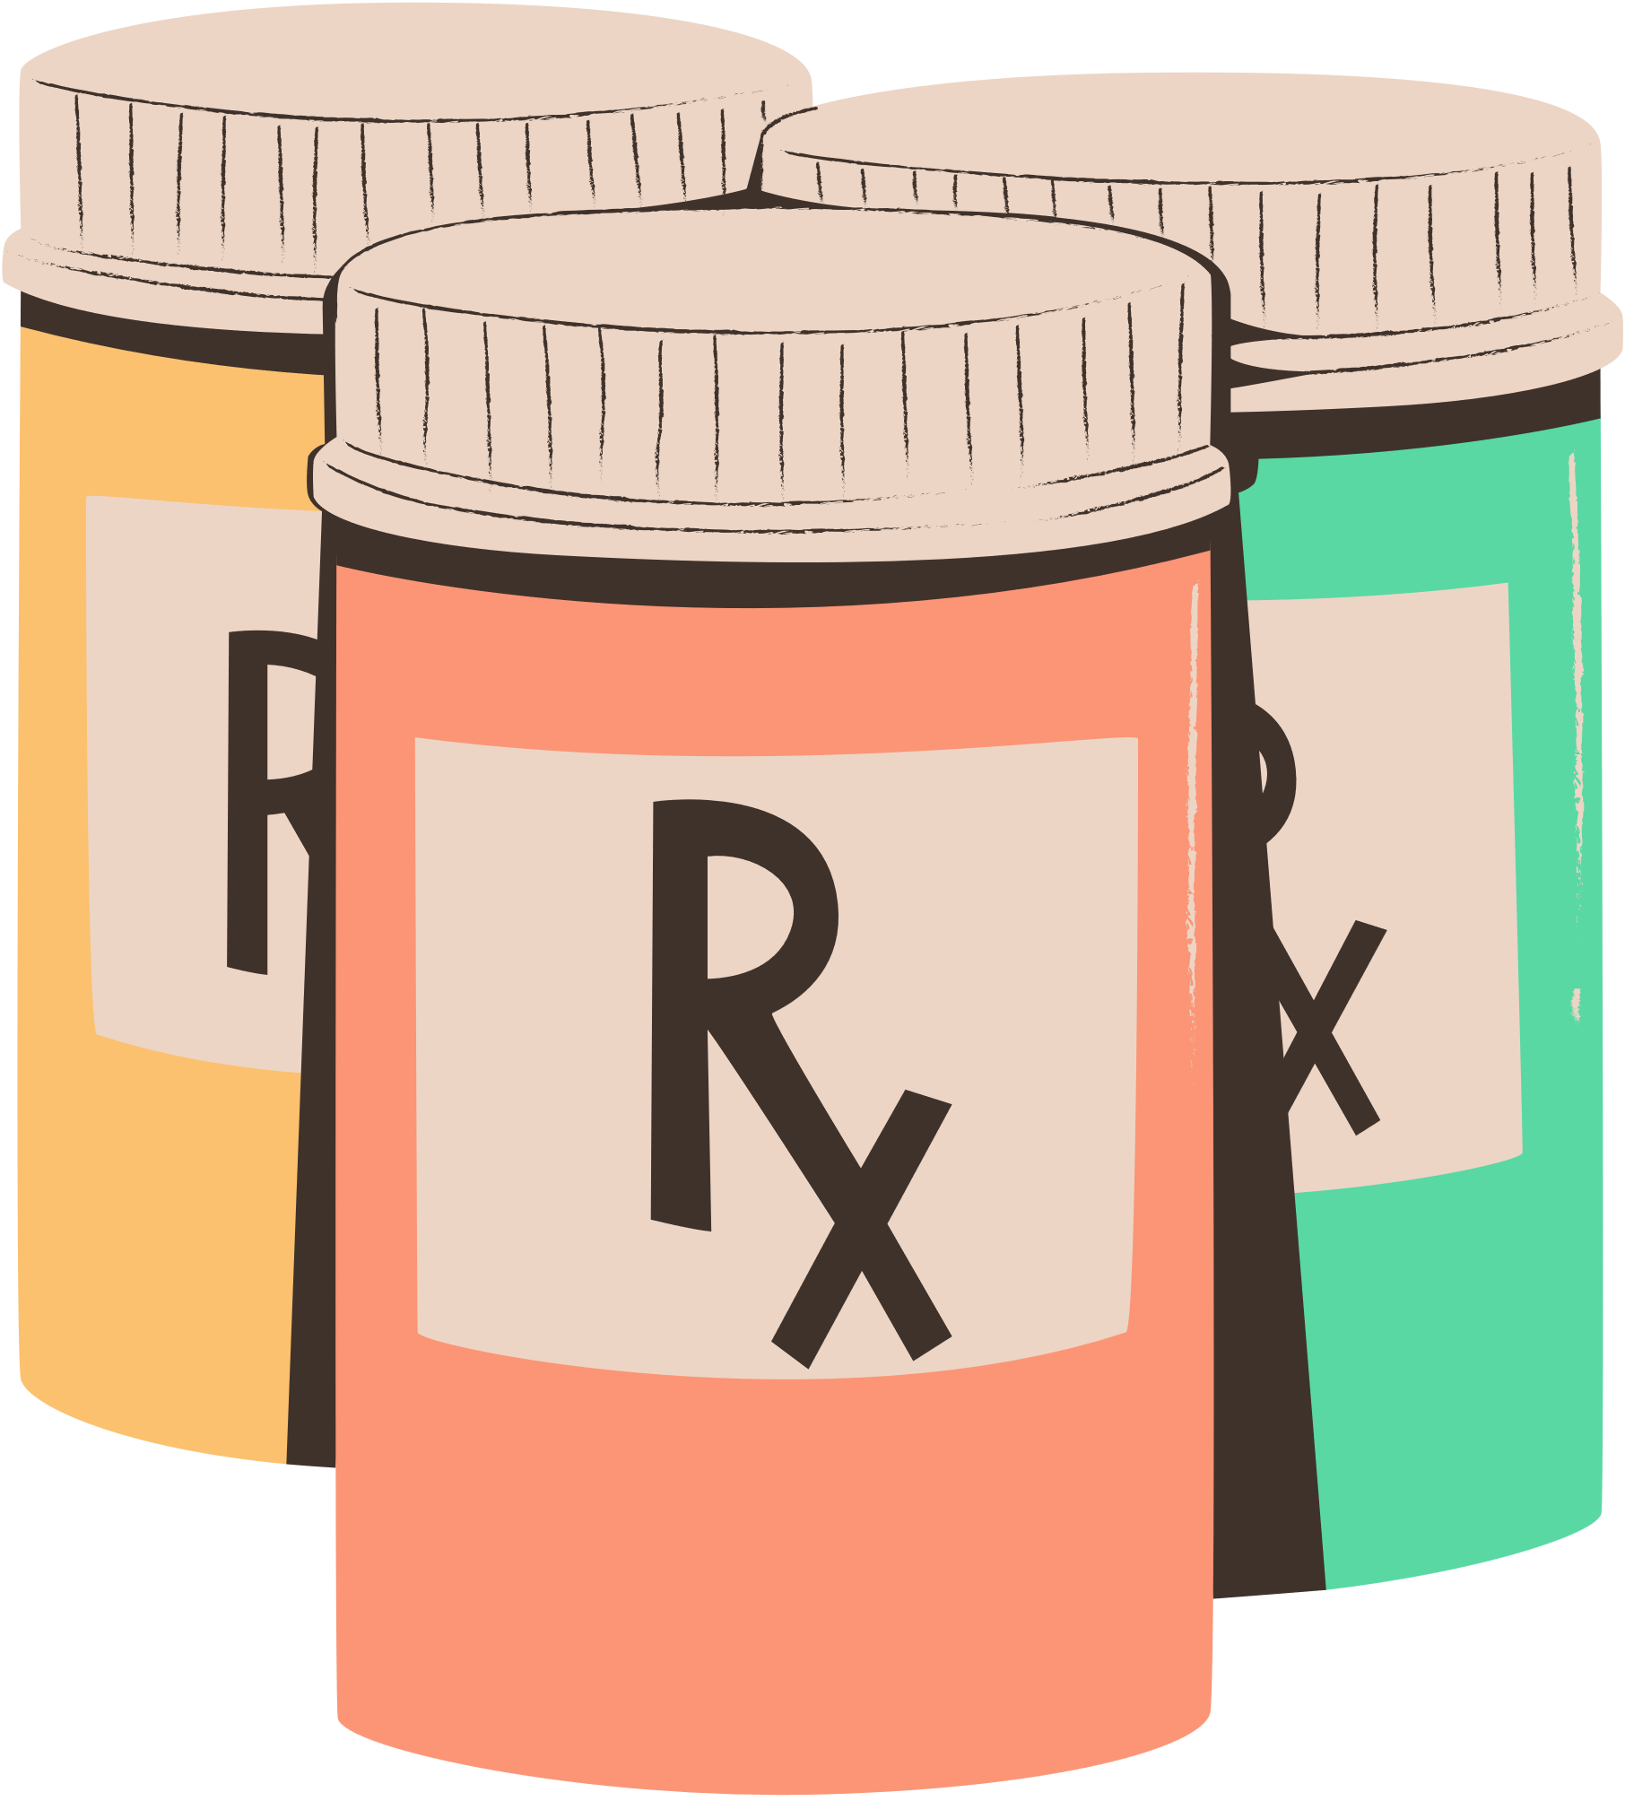
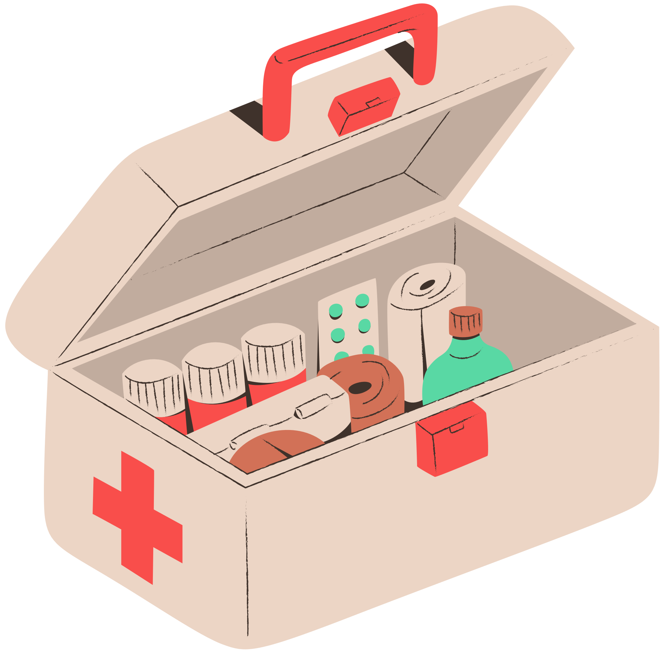
Tech Stack
Layer | Tools & Technologies
Frontend | Streamlit, HTML/CSS, Streamlit-Chat
Backend AI | HuggingFace Transformers (BERT, RoBERTa), Gemini Pro
Mental Health | Sentiment analysis using RoBERTa
Database | Firebase (cloud), SQLite (offline)
Hosting | Streamlit Cloud, GCP, Localhost
Voice Input (Future) | Whisper or Google Speech-to-Text

Slide 8

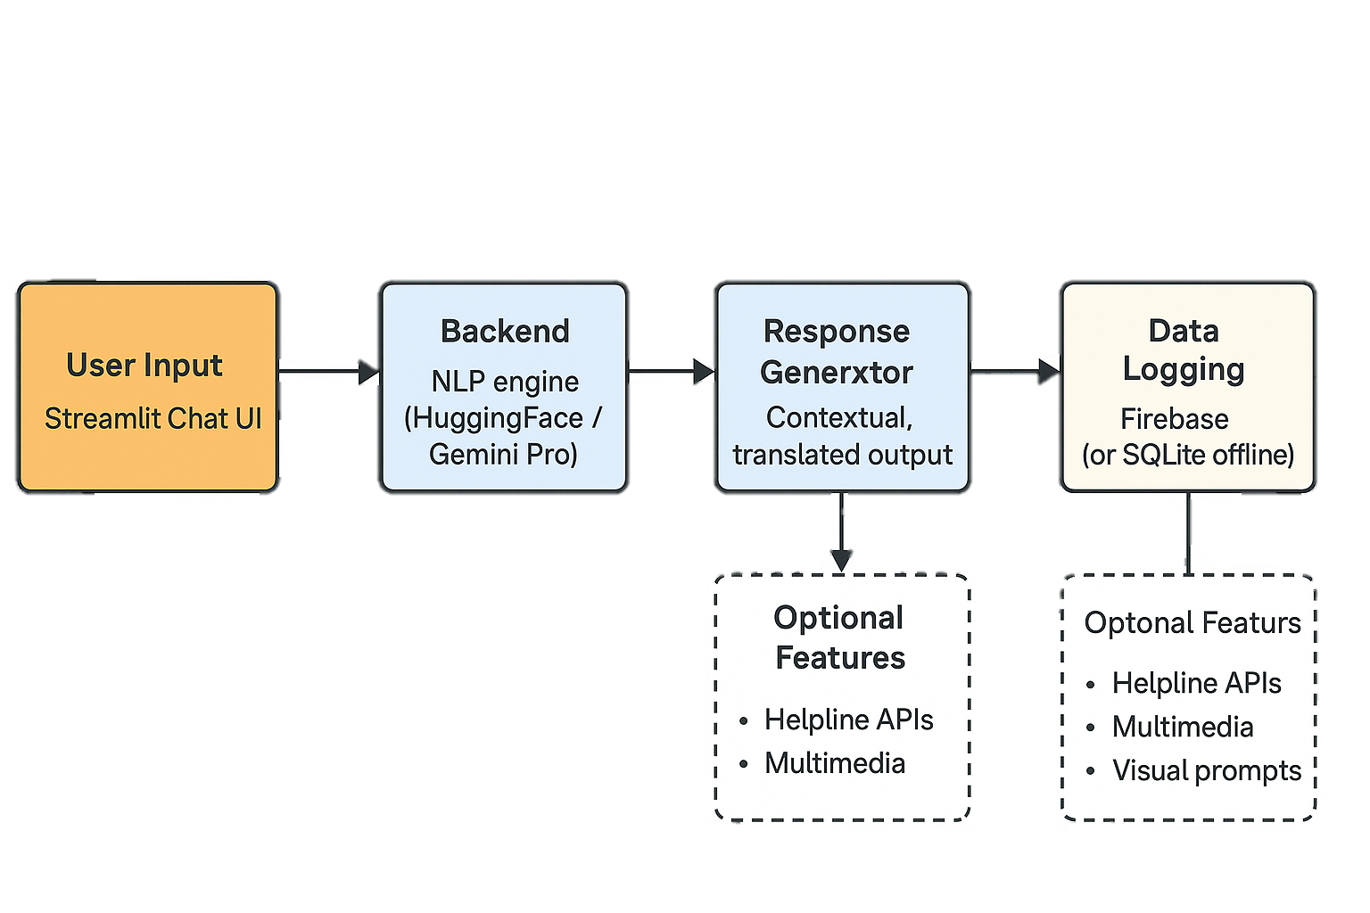

Architecture Diagram
System Architecture Overview

Slide 9

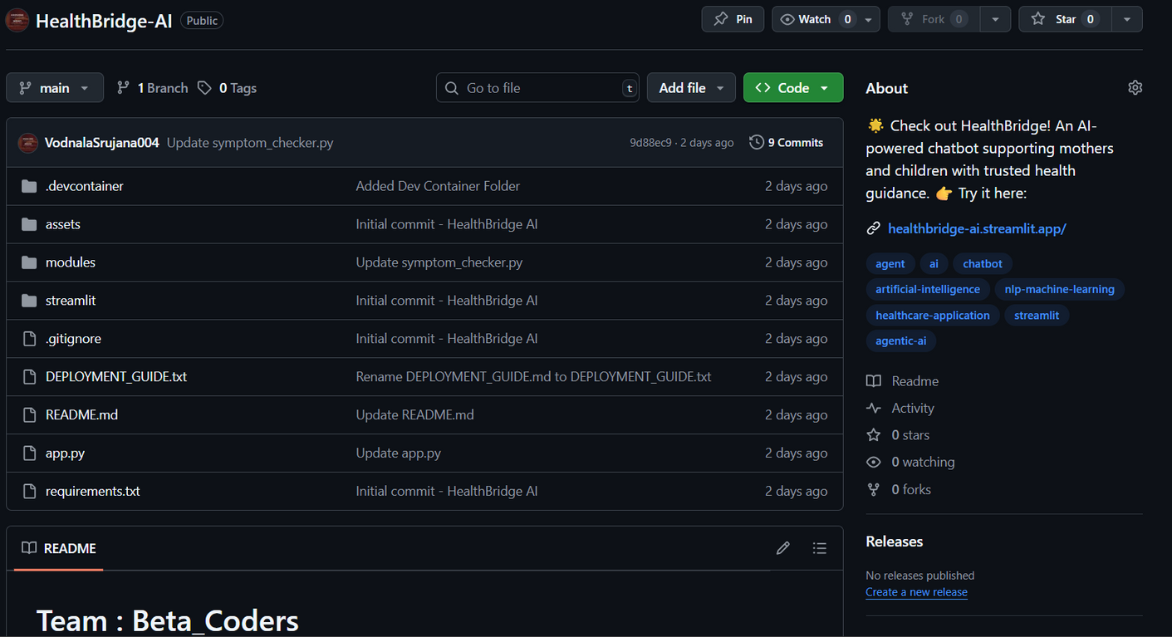
Implementation & Output
Codebase: https://github.com/VodnalaSrujana004/HealthBridge-AI

Slide 10
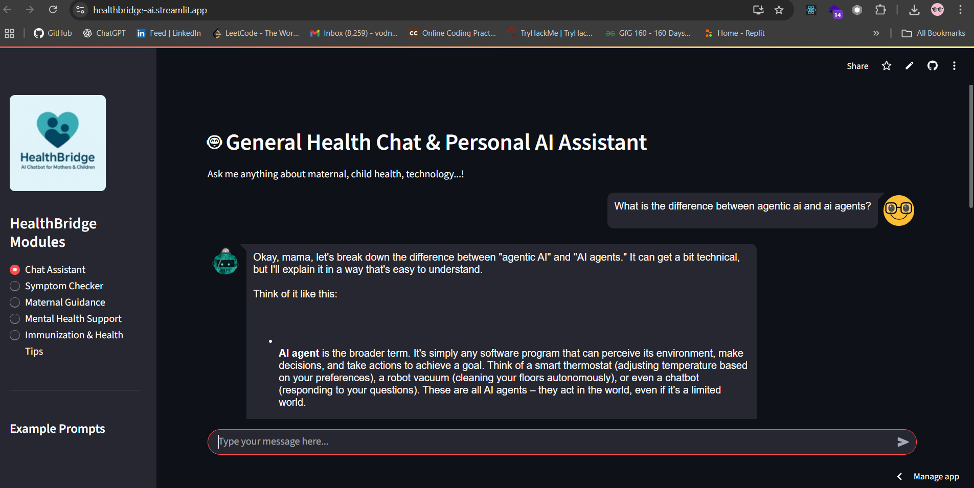
Deployed HealthBridge AI bot : https://healthbridge-ai.streamlit.app/

Slide 11
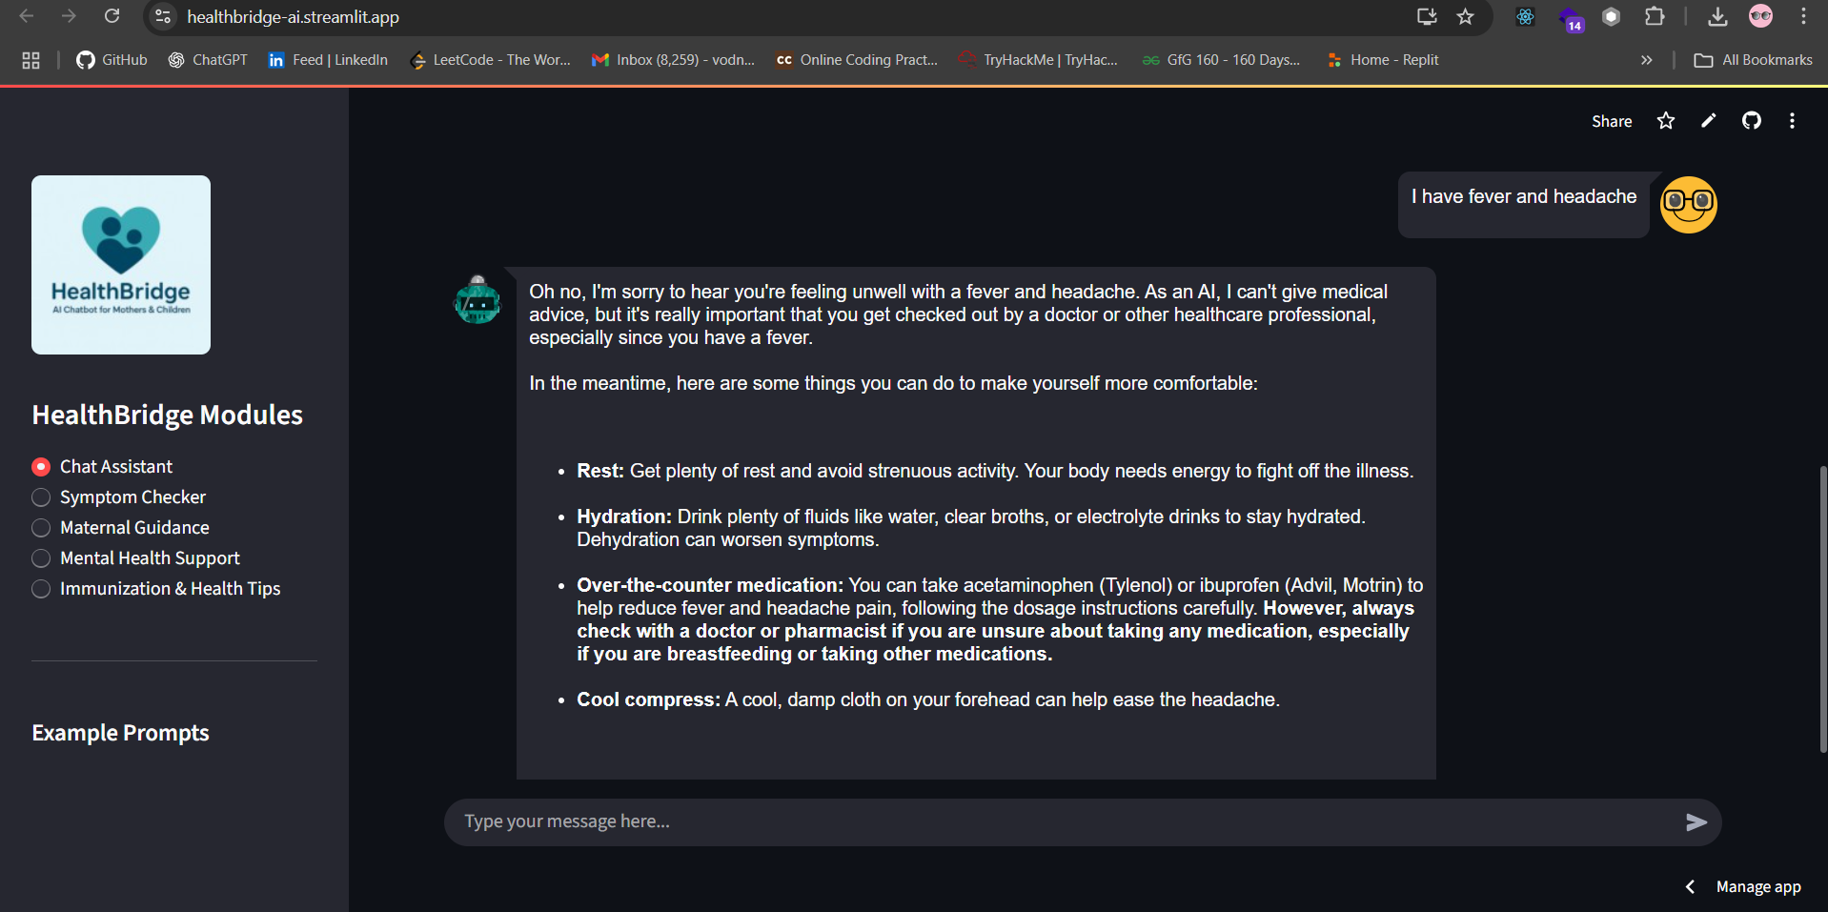

Slide 12
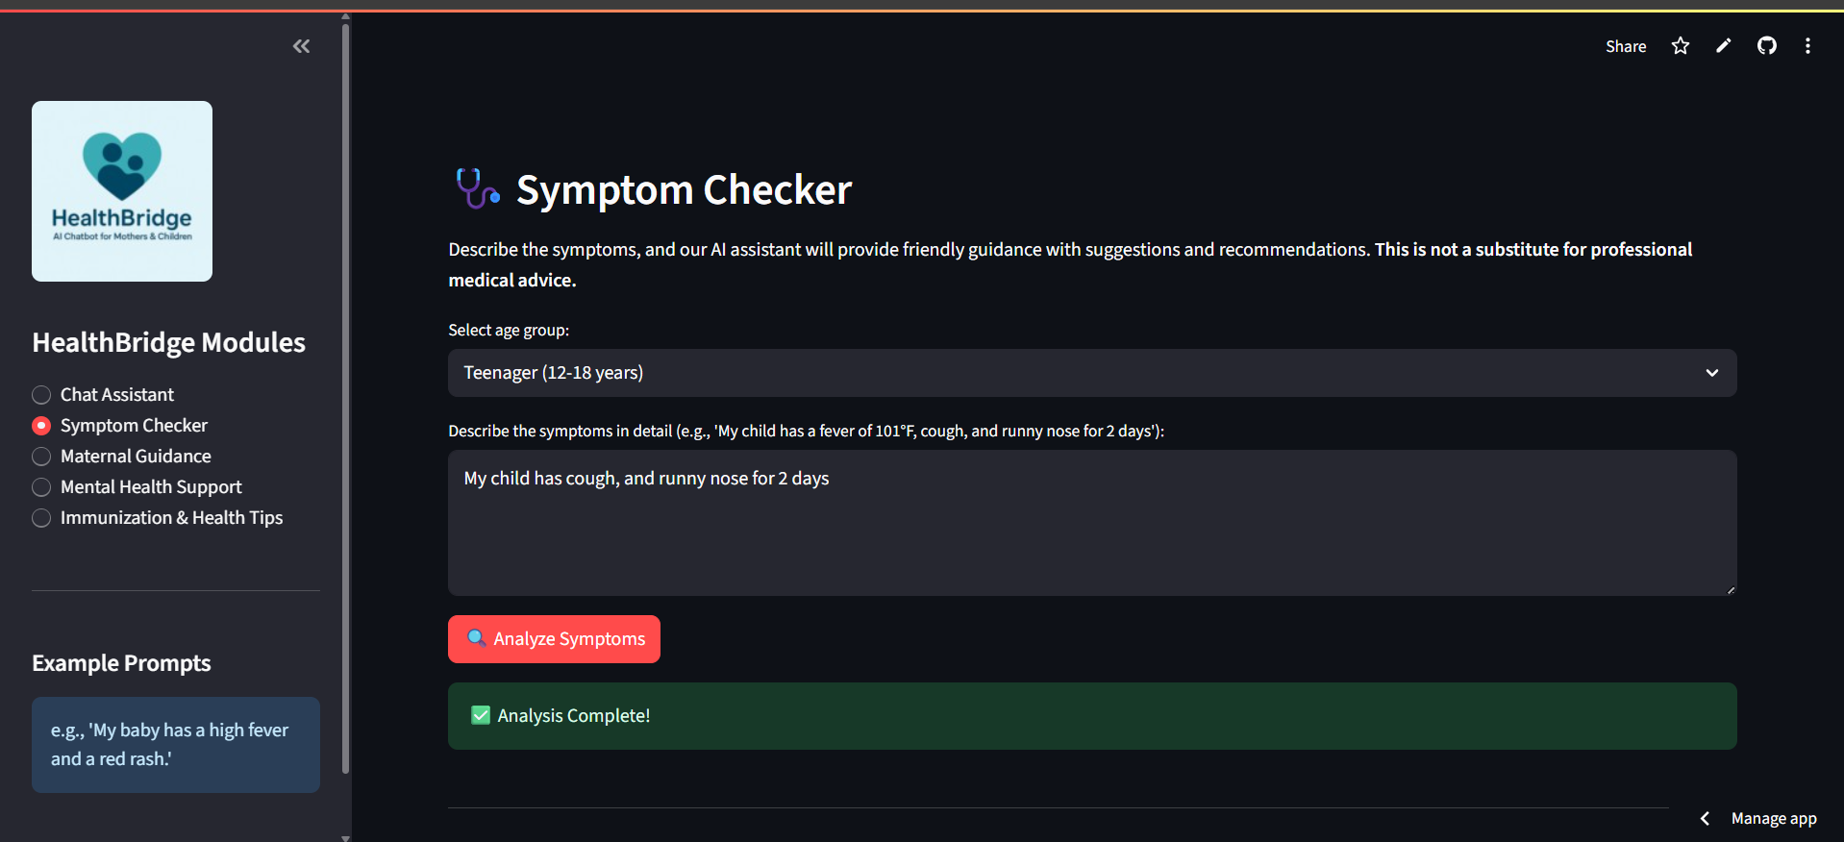

Slide 13
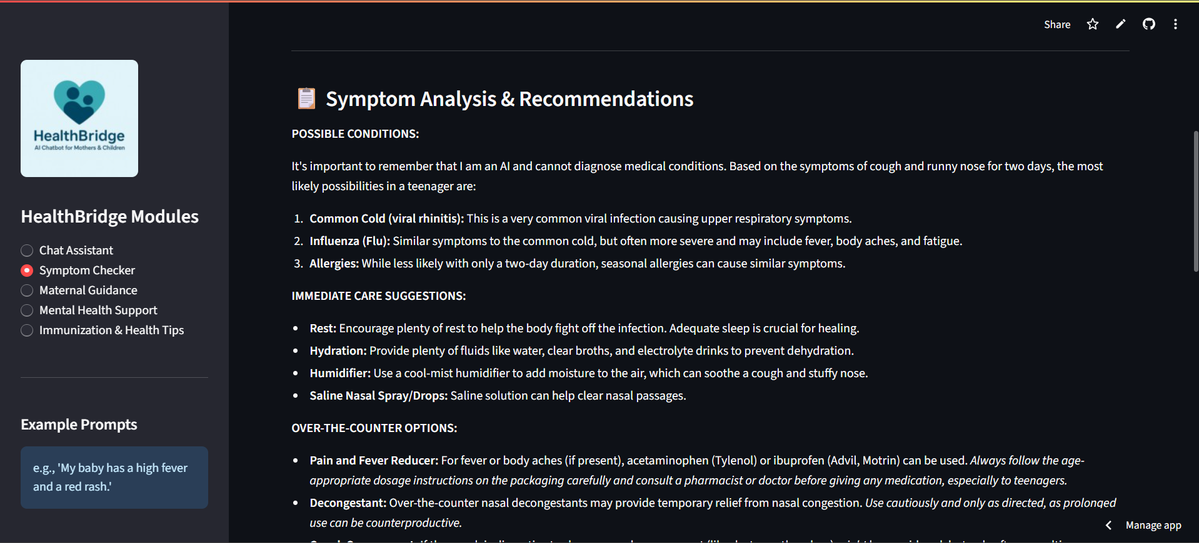

Slide 14
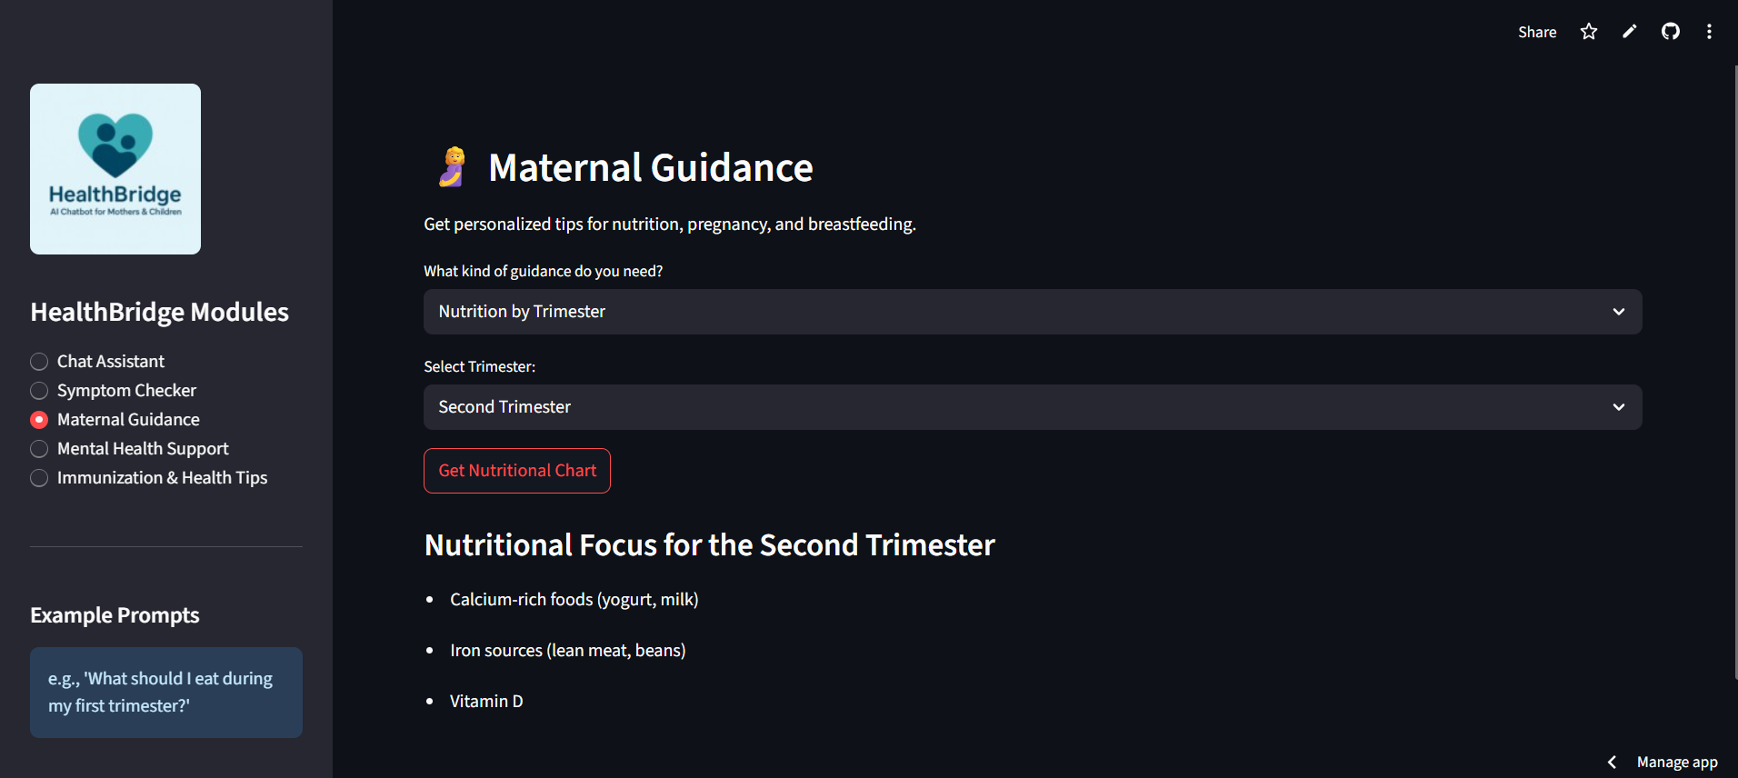

Slide 15
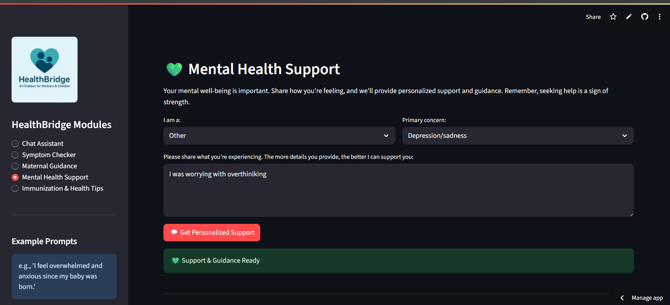

Slide 16
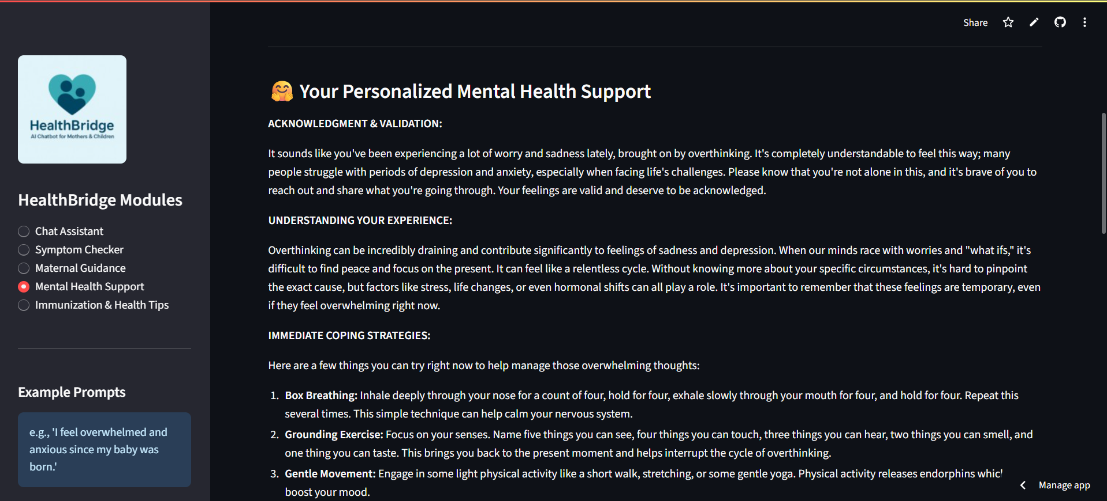

Slide 17
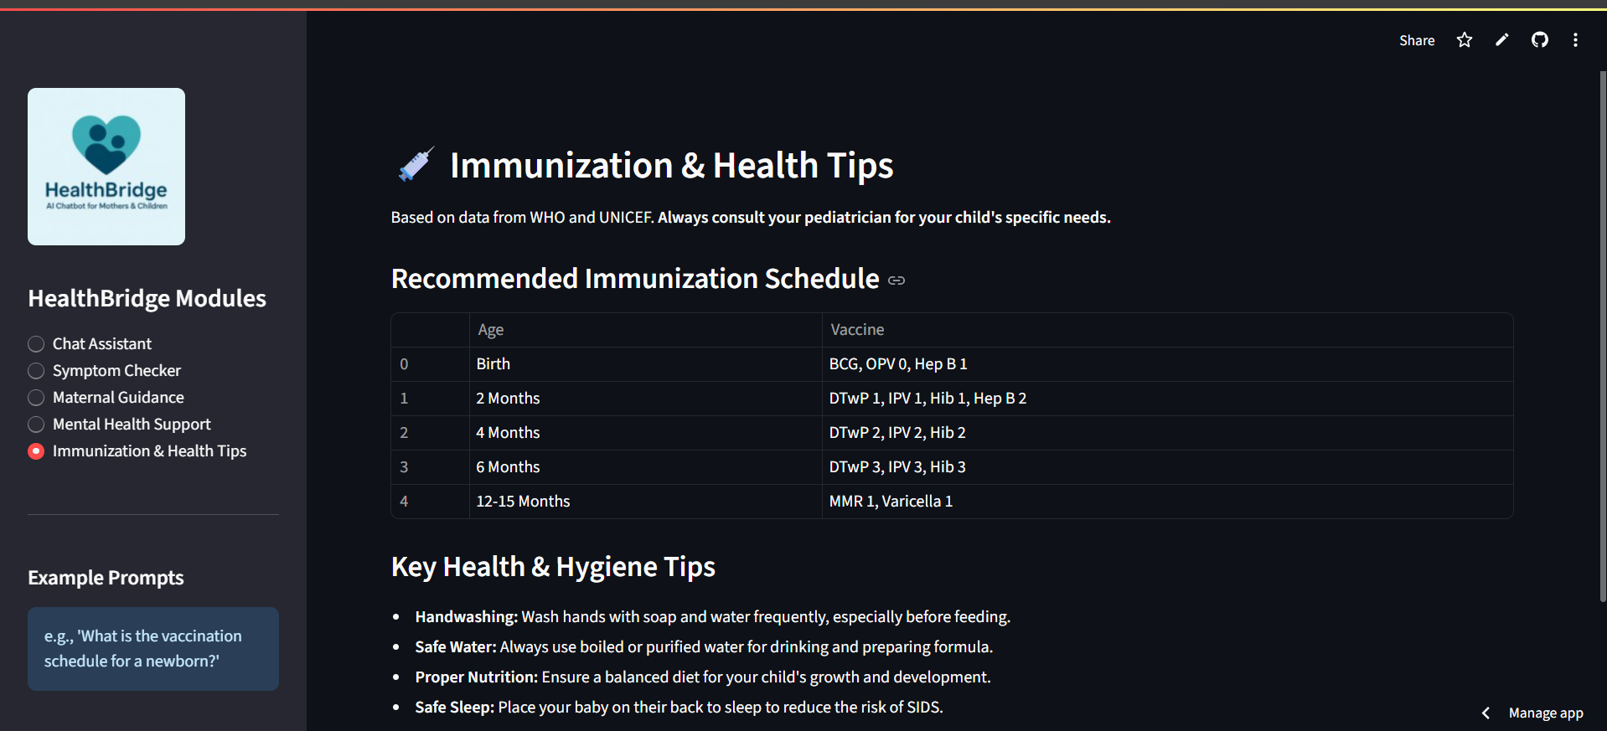

Slide 18

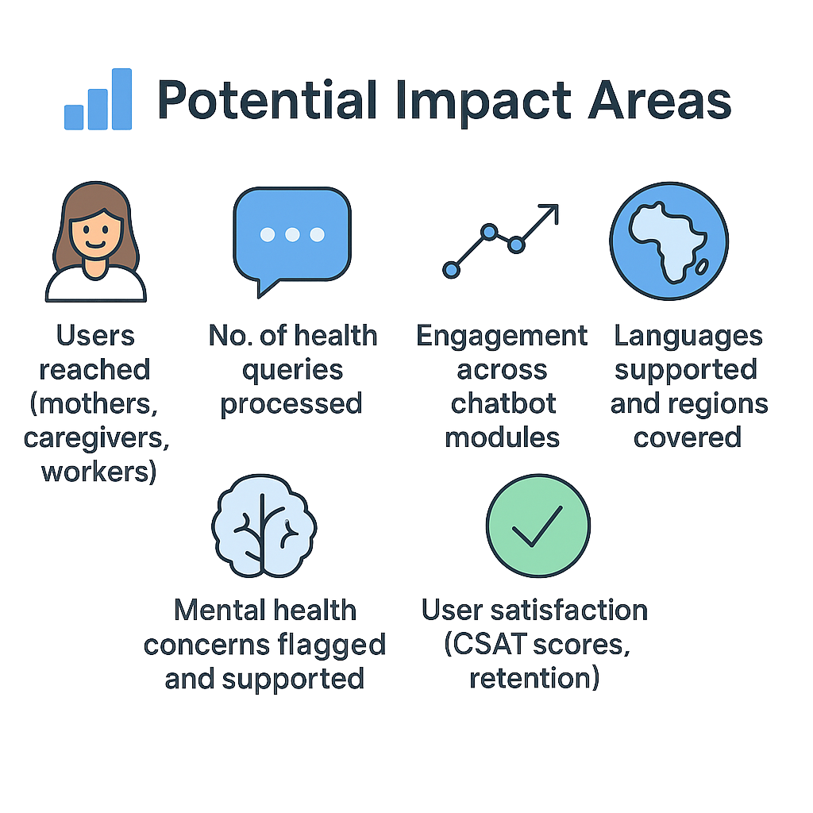
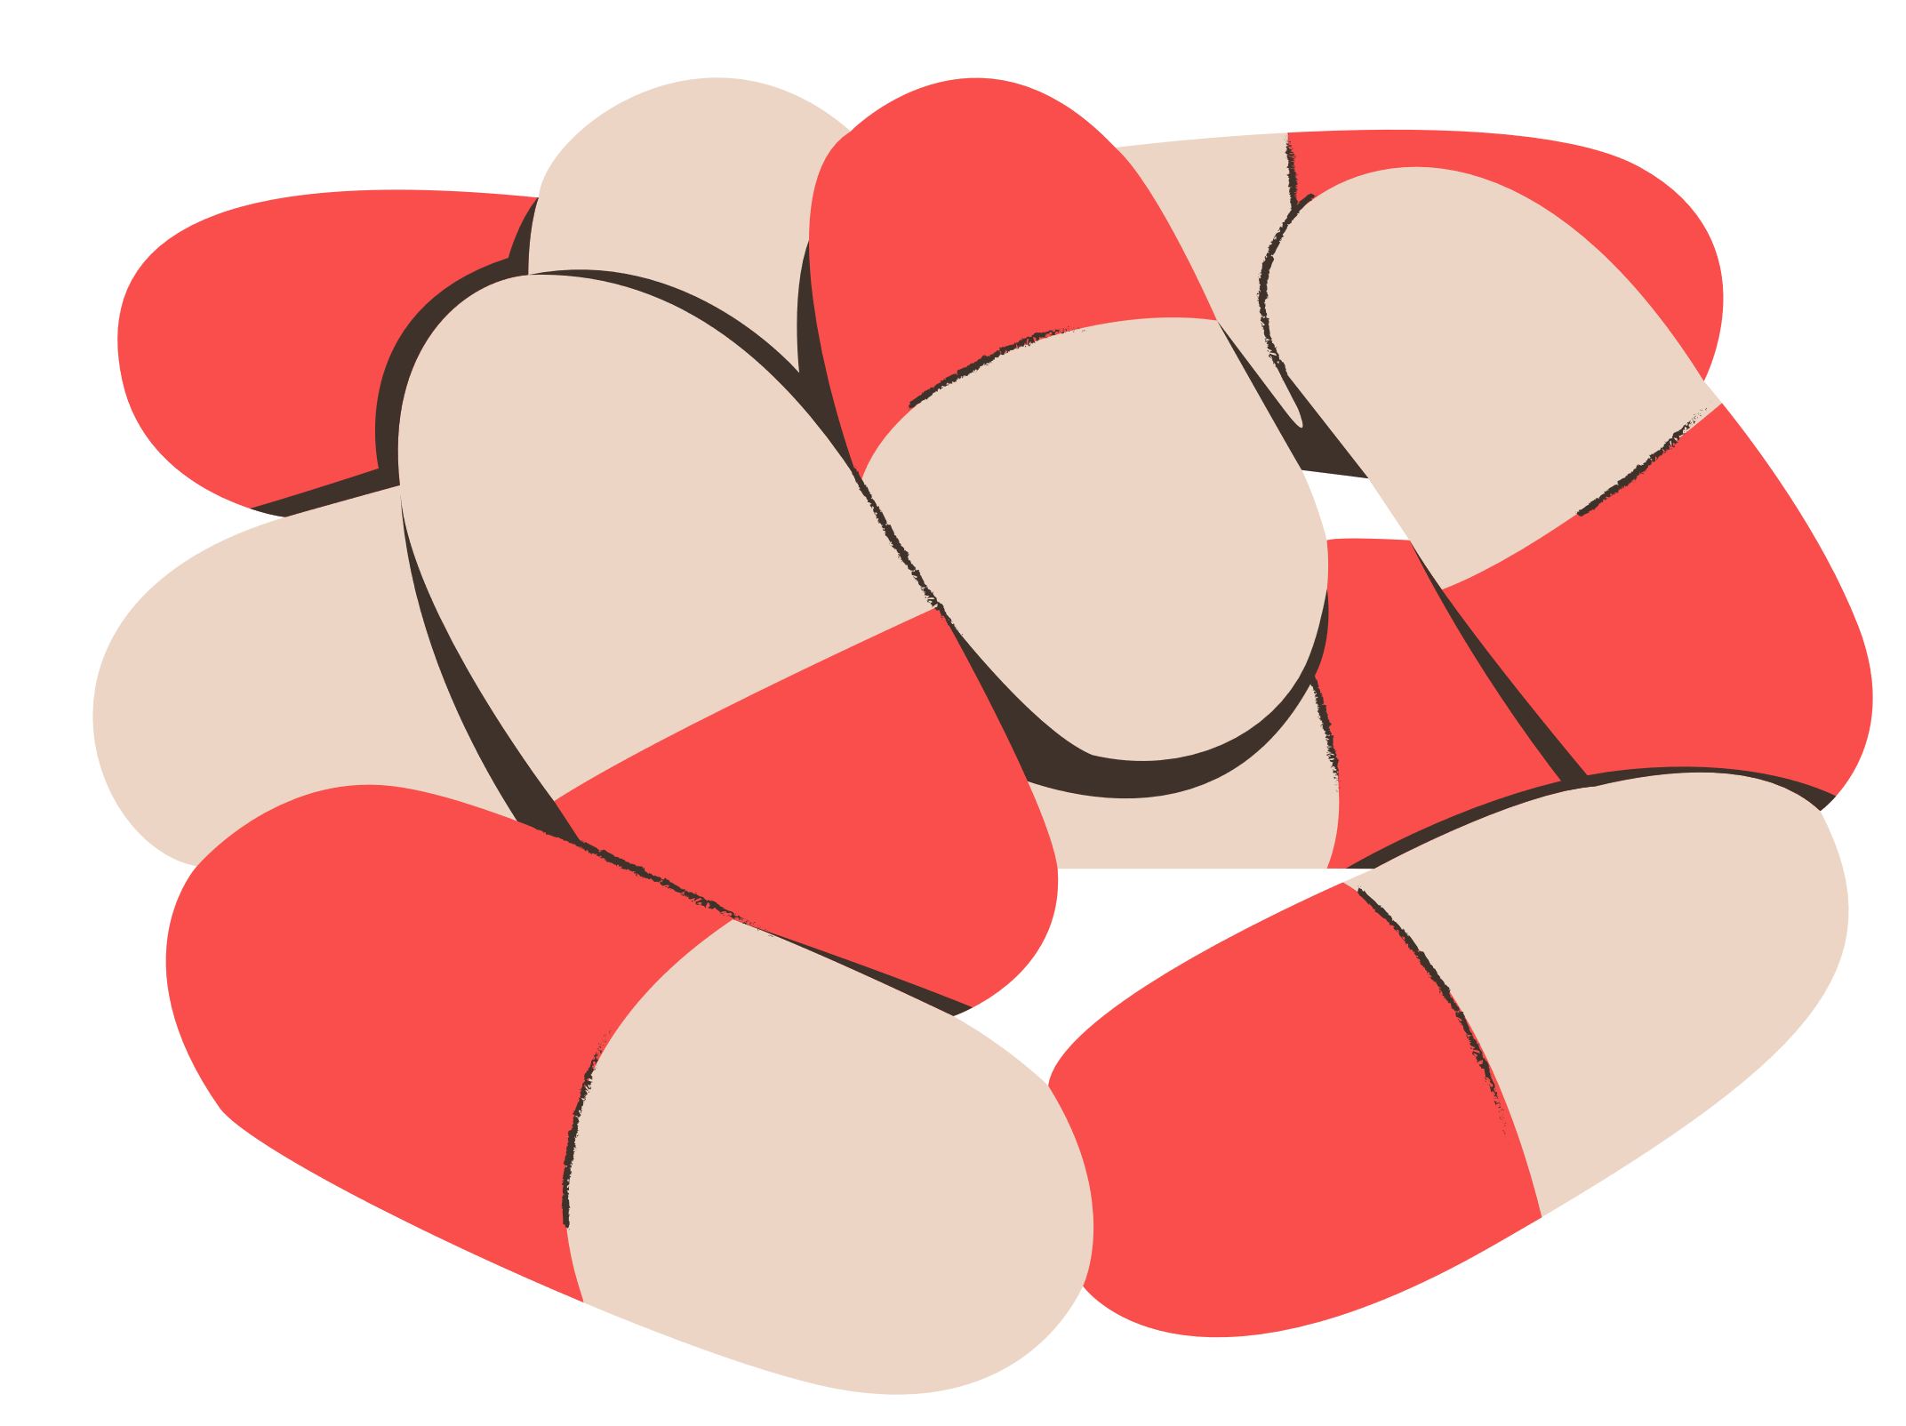
Impact Metrics
Potential Impact Areas

Slide 19

Target Audience
👥 Who Benefits from HealthBridge?
Pregnant women & new mothers in rural/semi-urban regions
Fathers & caregivers with limited health awareness
ASHA/ANM workers as digital assistants in the field
Primary Health Centers, Anganwadis, NGOs
Low-literacy, non-English-speaking users across India

Slide 20

Scalability & Future Scope
What’s Next?
Mobile app version with voice/text-to-speech
WhatsApp & Telegram bot integration
HealthBridge Kiosks at PHCs
Partnerships with NHM, CSR, UNICEF, NGOs
AI-powered risk prediction (anemia, PPD, etc.)
Expand to other geographies & public health domains

Slide 21
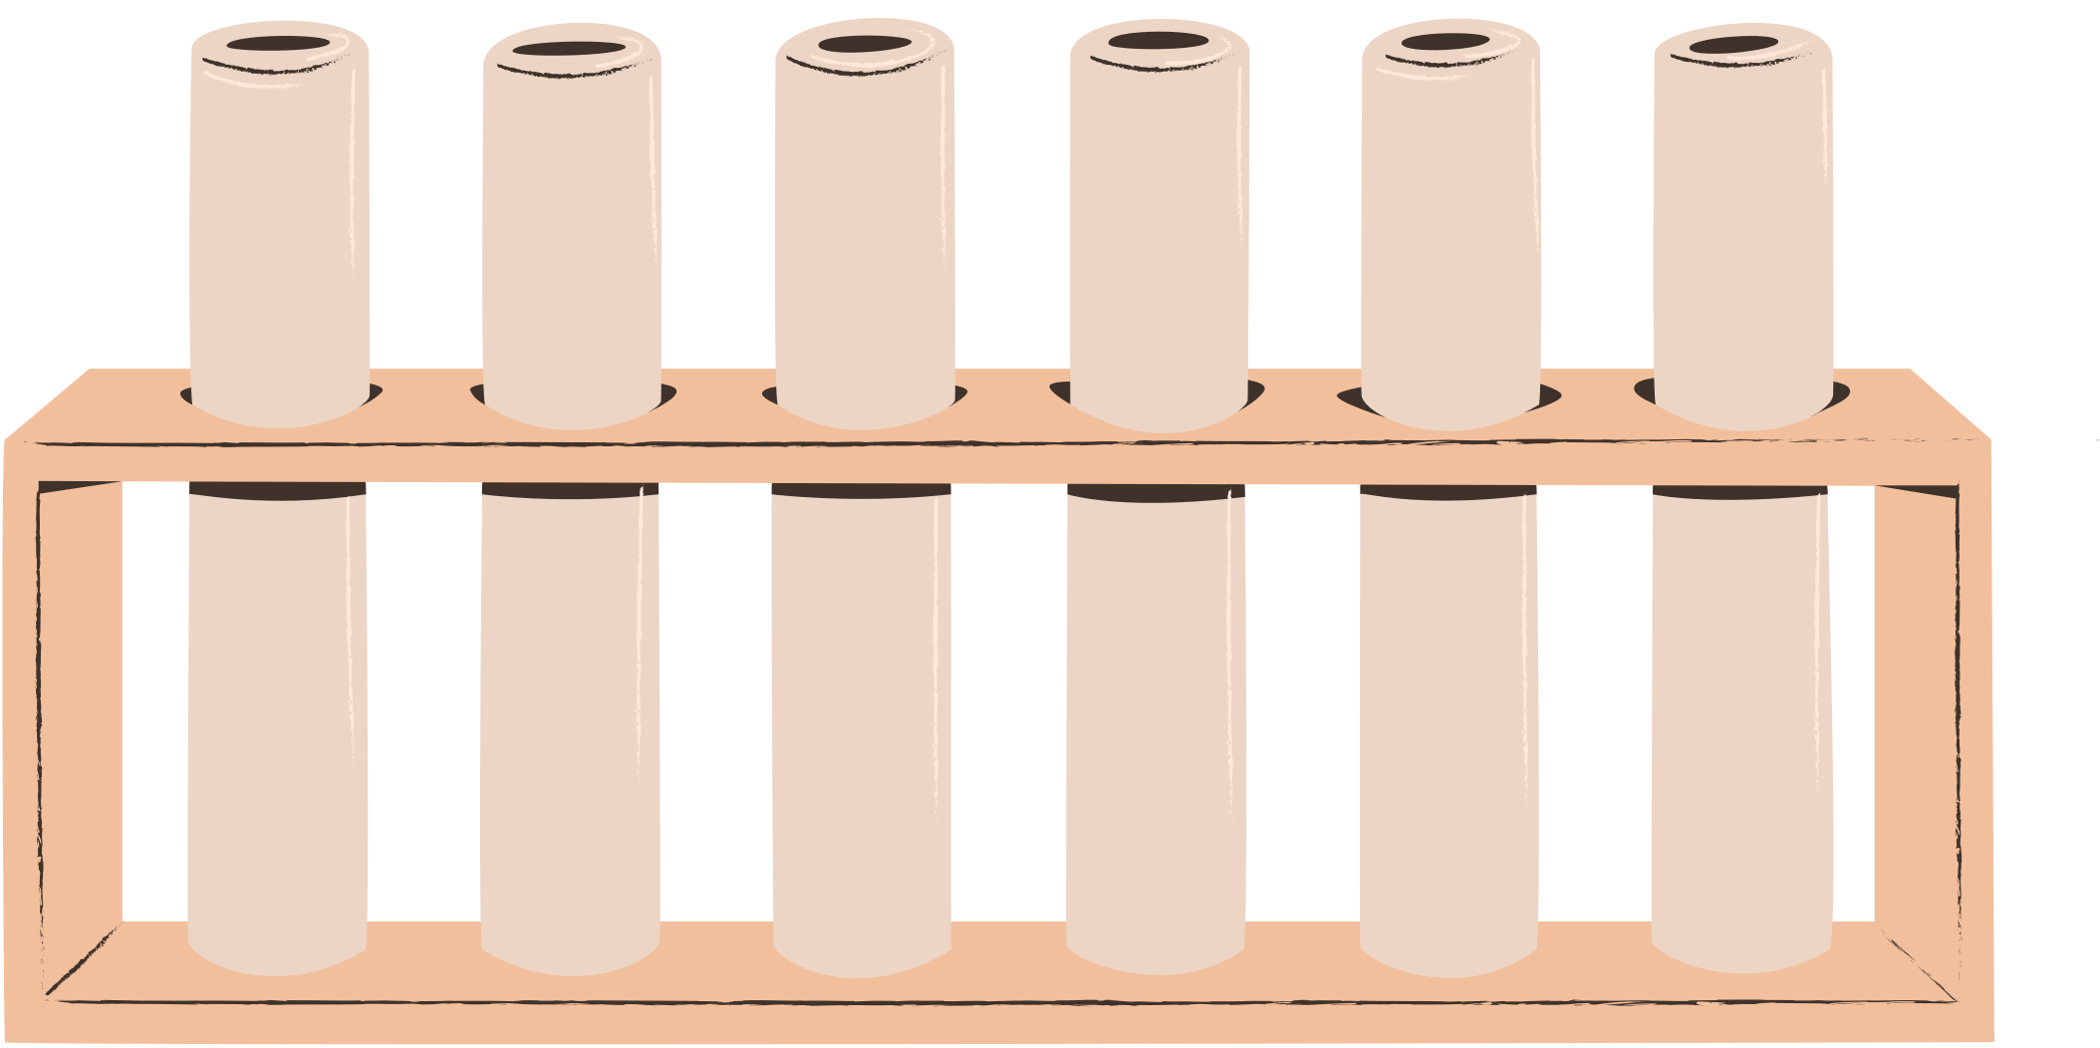
How We Grow ?
Business & Sustainability Plan
Free for individual use
Subscription dashboards for NGOs, PHCs, govts
Eligible for grants – WHO, Digital India, Gates Foundation
Promote via health campaigns, CSR, village radio
Scale via ASHA training and rural outreach

Slide 22
Conclusion
Aligned with SDG 3: Good Health and Well-being, HealthBridge is not just a chatbot, it's a companion for care, equity, and empowerment.
Final Thoughts
HealthBridge isn’t just a chatbot.
It’s a digital companion for every mother left behind by traditional healthcare.
Empathetic, intelligent, and inclusive
Built by students, backed by science
Driven by purpose, designed for impact

Slide 23
Let’s build equitable healthcare
one conversation at a time.
Important Links:
🔗 GitHub Codebase: github.com/VodnalaSrujana004/HealthBridge-AI
🌐 Try it now: https://healthbridge-ai.streamlit.app/ (deployed model)
Team: Beta_Coders
📧Reach us: vodnalasrujana29@gmail.com

Slide 24

Thank you..!

